Slide 1
Chapter 6 and 7
Labor
Delivery
The first few days

Slide 2
Lesson Essential Question
How do expectant parents plan for care of the baby?
Explain how and why a budget is necessary?
What childbirth choices are available to most parents?
In what ways do parent prepare for the birth of their child?
What are signs that labor has begun?
What are the major events that occur during each stage of labor?
What does a newborn look like at birth?
What are common hospital procedures following the birth of baby?
What are the special needs of premature babies?

Slide 3
Chapter Vocabulary
APGAR Cesarean section
Contraction Dilate
Fixed expenses Flexible expenses
Fontanels Forcepts
Incubator Labor
Maternity Leave Obstetrician
Paternity Leave Post partum

Slide 4
Weight Gain

Slide 5

Maternity Leave
How long?
Paid?
Purpose?
Paternity Leave
How long?
Paid?
Purpose?

Slide 6


Pediatrician
What do they specialize in?
How do you make a decision?
Some questions to ask…

Slide 7
Breast or Bottle
Which is better? Advantages/Disadvantages

Slide 8
Advantages of Breast
Disadvantages of Breast

Slide 9
Advantages of Bottle
Disadvantages of Bottle

Slide 10
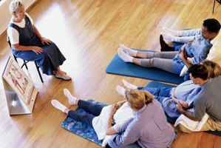
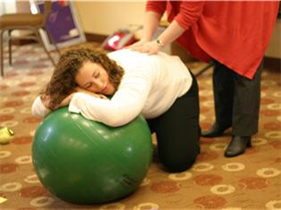
Child Birth Choices
Prepared/Natural
Lamaze
Bradley
LeBoyer
Hypnobirthing
Water Birth
www.lawrencehealth.org
www.scienceandsensibility.org

Slide 11
Prepared Childbirth
http://www.youtube.com/watch?v=HhzYO12KIDU

Slide 12
Lamaze
Birth is normal.
The experience of birth profoundly affects women and their families.
Women's inner wisdom guides them through birth.
Women's confidence and ability to give birth is either enhanced or diminished by the health care provider and place of birth.
Women have a right to give birth free from routine medical interventions.
Birth can safely take place in birth centers and homes.
Childbirth education empowers women to make informed choices in health care, to assume responsibility for their health and to trust their inner wisdom.
http://www.youtube.com/user/Lamaze1

Slide 13
Bradley Method
The Bradley method is a natural childbirth approach that involves prenatal education, relaxation techniques, and partner participation. The goal of Bradley method training is to ensure a safe birth with reduced pain and anxiety.
Critics point to the absence of controlled studies showing that it works, a sense of distrust in health-care professionals in the teachings, the for-profit nature of the organization and the reliance on extensive coaching from the partners as weaknesses to this method.
http://www.youtube.com/watch?v=88K1smHkHQE

Slide 14
LeBoyer
The birthing room is darkened or dimmed. Doing so prevents sudden contrast of light that might distress the newborn.
A soft music is played or at least harsh noises are kept to a minimum. All the talking inside the delivery room is done by whispering.
Newborns are handled gently and carefully. Leboyer recommends not pulling the baby’s head to completely allow a natural childbirth.
The infant receives a warm bath immediately after birth for relaxation.

Slide 15

Hypnobirthing
http://www.youtube.com/watch?v=ZE5FUbP6z2Y&list=PL056A39EA07B4C568

Slide 16
Water Birth
Some moms believe a water birth is a more natural and less stressful experience for them and their new baby. A water birth may give a woman a sense of control over her delivery. Water provides natural buoyancy, which makes the mother feel lighter. Water relaxes the mother, allowing her to concentrate on the birth. Water relaxes the mother's muscles and improves blood flow. Water may reduce vaginal tearing, thus helping the mother avoid an episiotomy or stitches. A water birth may shorten the first stage of labor and reduce the need for anesthesia

Slide 17
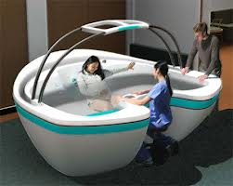
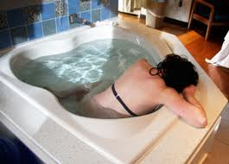

Slide 18
Who will deliver?
Obstetrician
advantages
disadvantages
Family Doctor
advantages
disadvantages
Midwife
Lay
Certified
Doula

Slide 19
Doula
A doula is a professional trained in childbirth who provides emotional, physical and informational support to the mother who is expecting, is experiencing labor, or has recently given birth. The doula’s purpose is to help women have a safe, memorable and empowering birthing experience.
During delivery, doulas are in constant and close proximity to the mother. They have the ability to provide comfort with pain relief techniques that include breathing techniques, relaxation techniques, massage, and laboring positions
After the birth, many labor doulas will spend some time helping mothers begin the breastfeeding process and encouraging bonding between the new baby and other family members

Slide 20
Where will the baby be born?
Hospital
Traditional
Family Based
Birthing Rooms
Alternate Birthing Centers
Advantages
Disadvantages
Home
Advantages
Disadvantages

Slide 21
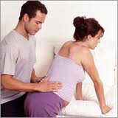
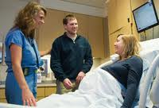

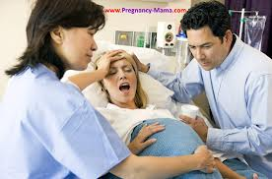
Signs of Labor
False Labor (BH)
Lightening
Bloody show
Water breaks
Contractions
Nesting
Dilation
Effacement

Slide 22
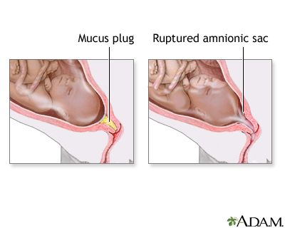

Slide 23
What happens when you
get to hospital?
Paperwork
Dressed
IV
Fetal monitor
external
internal
No doctor

Slide 24
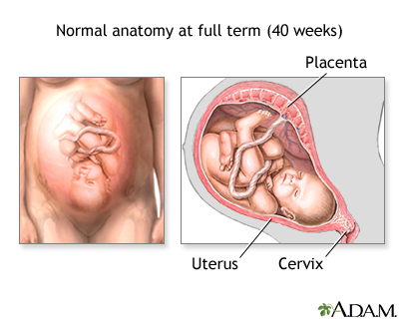
Labor
Stage 1

Slide 25
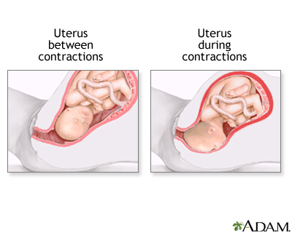

Slide 26
What happens during the first stage of labor?
Uterine muscles shorten and thicken
Lasts from minutes to 36 hours
Mom stays upright
Dilation and effacement
Relaxin/Pitocin
Contractions get longer and stronger
Baby continues to move down
Mom needs to relax and rest between contractions
If contractions are too painful, water can be broken

Slide 27
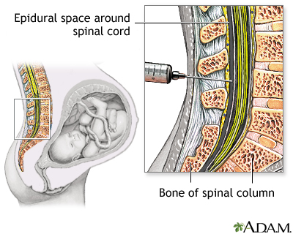
Given prior to 6cm and refreshed
Pain becomes bearable not gone

Slide 28
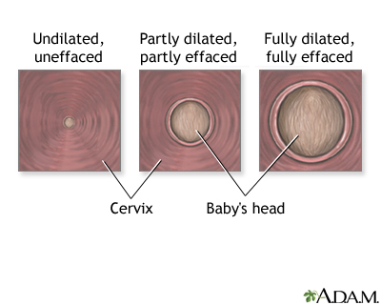

Slide 29
By the end of stage 1…
You will feel ready to push but cannot
Contractions will be about 2 min apart
Last about 90 seconds
These are very intense contractions
Some say this is the most difficult part of the labor

Slide 30
Stage 2 of Labor
This stage lasts 5 min to 6 hrs
This is when the baby is born
Contractions in this stag are very different
You will feel the need to push
Everything is more intense and require concentration

Slide 31
How is the baby able to fit through?
Pelvic bones---ligaments
Vagina stretches
Fontanels
Episiotomy

Slide 32
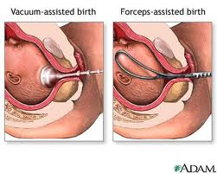
During this time, mom will…
Feel the need to push
Partner and doctor will use monitor

Slide 33
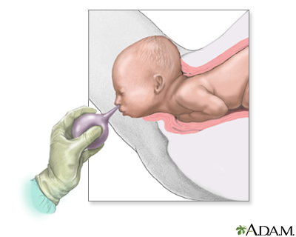
The head emerges first
Shoulders eased out
90 second rule
Suction
Body
Lay on mom’s chest
Clean baby up

Slide 34
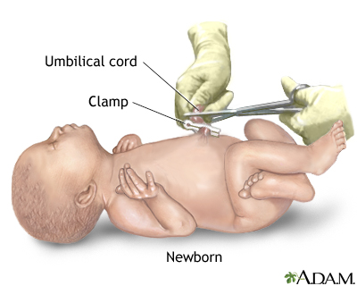
Once the baby is out and breathing…

Slide 35
It’s not over yet!
Stage3
The birth of the placenta
Lasts from 2 min to 30 min
Mom doesn’t do much

Slide 36
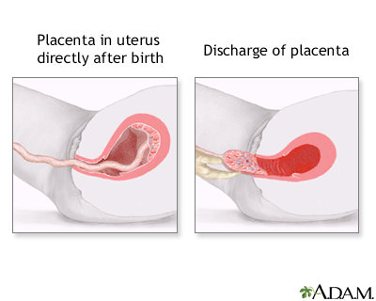

Slide 38
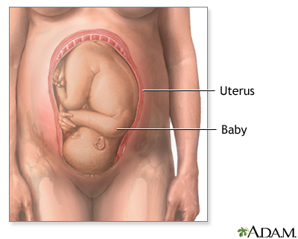
Cesarean Section

Slide 39
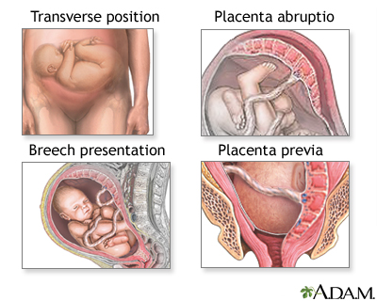
Reasons for a C-section
Fetal distress
CPD
(cephalopelvic disproportion)
Herpes
Prior C-sections

Slide 40
Normal Procedures
Abdomen shaved and washed
Catheter
Sterile drapes
Partner dressed
Spinal block

Slide 41
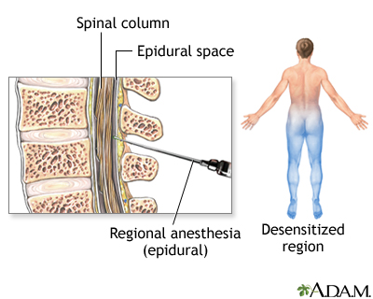

Slide 42
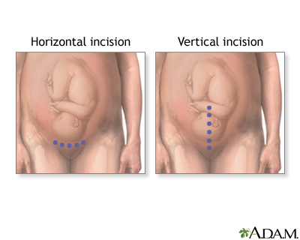
Abdomen is tested for feeling

Slide 43
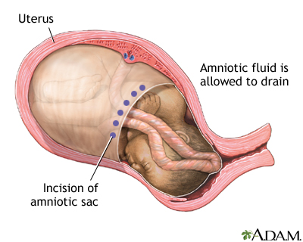
Incision made in stomach
Second incision made in uterus
Fluid is cleared

Slide 44
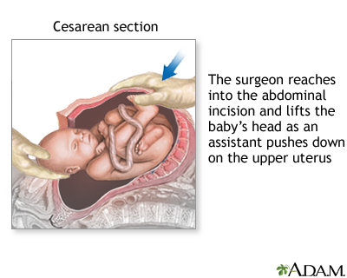

Slide 45
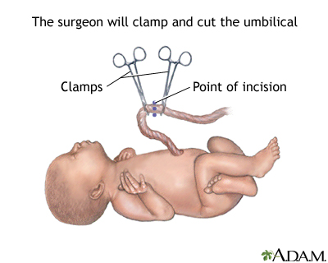

Slide 46
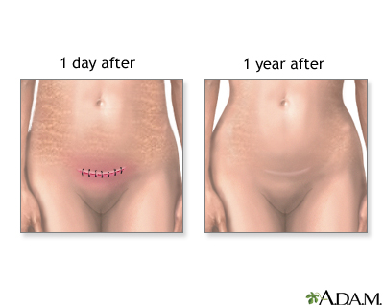
The placenta is removed
Uterus stitched
Stomach stitched

Slide 47
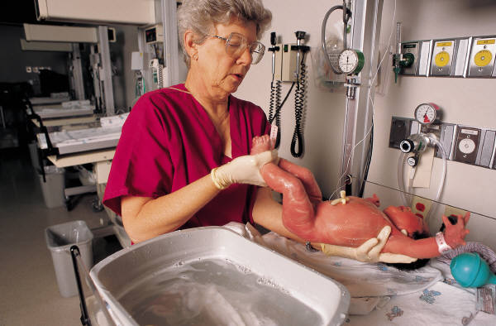

What will baby look like?
Head
Hair
Ears
Eyes
Fingers
Milia
Lanugo/vernix

Slide 49
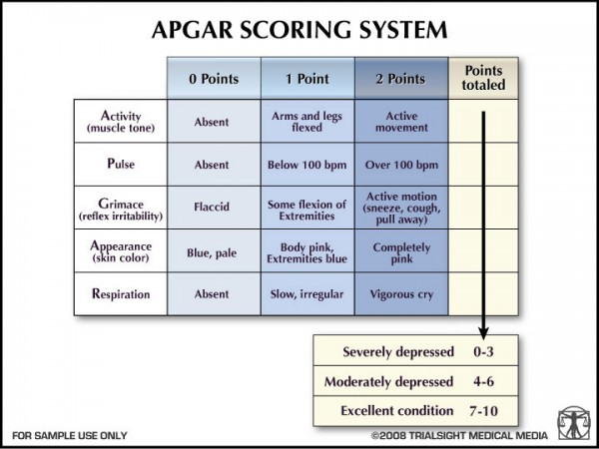

Slide 50
Test for baby after birth
APGAR
Vitamin K
Eye Drops
Blood test (5)
Hearing

Slide 51
Jaundice
Bilirubin
Build up in skin
Liver not mature
RBC broken down
Treatment:
Hospital
Home

Slide 52

Mom’s Hospital Stay
Blood pressure
Temperature
Bleeding
Rooming in
Complete info for BC

Slide 53
Premature Baby
Size and time
Common problems
Incubator
Monitored
Control before going home
NICU
If premature labor is detected, it can be stopped.

